Slide 1
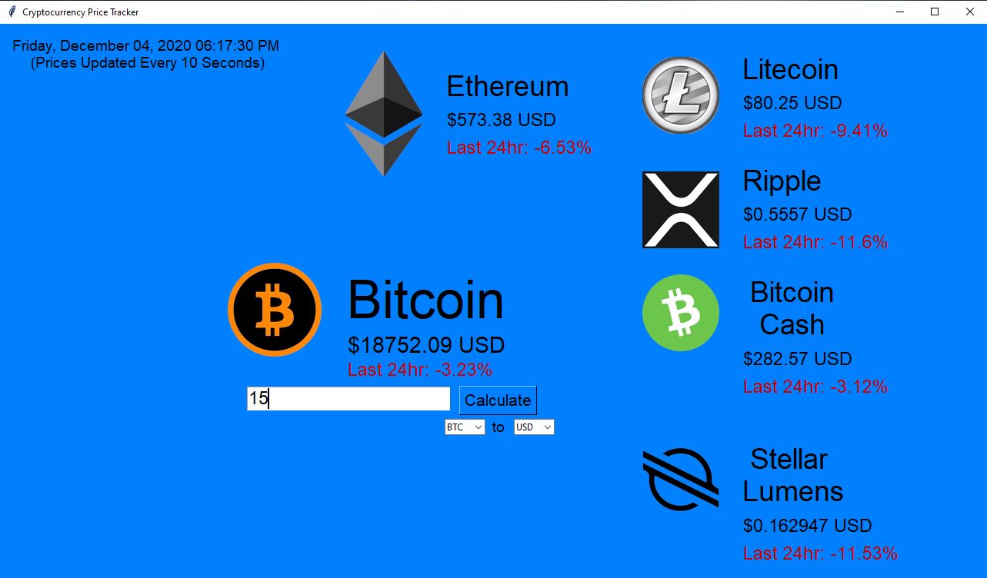
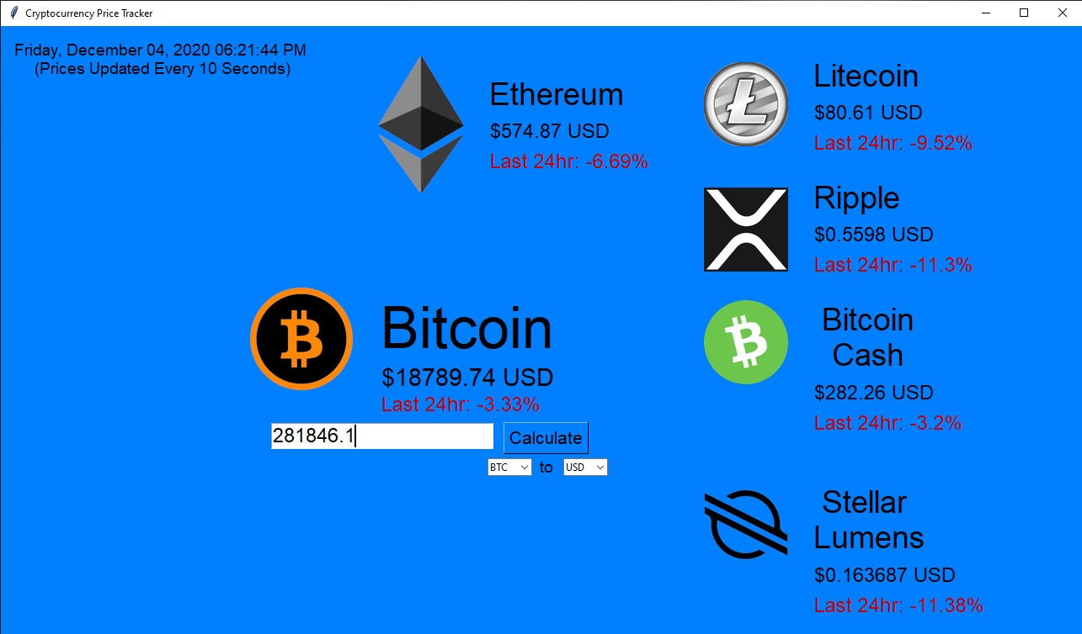
Cryptocurrency Price Tracker
Tracking the prices of the world’s top Cryptocurrencies
Original Code By: Austindavissmith
Modified By: Logan Zimmerman
https://github.com/ksu-is/Cryptocurrency-Price-Tracker

